Slide 1
Structured Query Language
DB2 Training Class 02

Slide 2
Introduction to SQL
Structured Query Language (SQL) is a standard language used to work with database objects and the data they contain.
  Using SQL, we can define, alter, and delete database objects, as well as insert, update, delete, and retrieve data values stored in database tables.
  SQL is not case sensitive but require a semicolon at the end of each SQL statement.
SQL statements can be executed interactively using tools and they can also be embedded in high-level programming language source code.

Slide 3

Database Tables
A database most often contains one or more tables. Each table is identified by a name (e.g. "Customers" or "Orders"). Tables contain records (rows) with data.
Below is an example of a table called "Persons“:
Person_Id | Last_Name | First_Name | City
A0001 | ANIL | P | HYD
A0002 | SRINU | D | PUNE
A0003 | SUNIL | B | BANG

Slide 4
Categories of SQL Statements:
DDL
    DDL is abbreviation of Data Definition Language. It is used to create and modify the structure of database objects in database.
    Examples: CREATE, ALTER, DROP statements
DML
    DML is abbreviation of Data Manipulation Language. It is used to retrieve store data, modify, delete, insert and update data in database.
    Examples: SELECT, UPDATE, INSERT, DELETE statements

Slide 5
Categories of SQL Statements:
TCL
    TCL is abbreviation of Transactional Control Language. It is used to manage different transactions occurring within a database.
    Examples: COMMIT, ROLLBACK statements
DCL
    DCL is abbreviation of Data Control Language. It is used to create roles, permissions, and referential integrity as well it is used to control access to database by securing it.
    Examples: GRANT, REVOKE statements

Slide 6
DDL Statements
The most important DDL statements in SQL are:
CREATE DATABASE - creates a new database
ALTER DATABASE - modifies a database
CREATE TABLE - creates a new table
ALTER TABLE - modifies a table
DROP TABLE - deletes a table
CREATE INDEX - creates an index (search key)
DROP INDEX - deletes an index

Slide 7
CREATE Statement
CREATE TABLE PROJECT
(PROJNO CHAR(6) NOT NULL, PROJNAME VARCHAR(10) NOT NULL, DEPTNO SMALLINT,
BUDGET DECIMAL(6,2),
STARTDATE DATE,
ENDDATE DATE) IN FSS197DB.FSS197TS;
CREATE TABLE EMPMAST
(EMPID SAMLLINT NOT NULL,
EFNAME CHAR(15) NOT NULL,
ELNAME VARCHAR(15) NOT NULL,
EMPDOB DATE NOT NULL,
EMPSAL DECIMAL(7,2),
EMPDEPT CHAR(5) NOT NULL,
PRIMARY KEY(EMPID)) IN FSS197DB.FSS197TS;

Slide 8
DB2 – COBOL DATATYPES
DB2 | COBOL
CHAR(n) | 10 FIELD-A PIC X(n)
VARCHAR(n) | 10 FIELD-A 49 FIELD-A-LENGTH PIC S9(4)COMP 49 FIELD-A-TEXT PIC X(n)
SMALLINT | 10 FIELD-A PIC S9(4) COMP
INTEGER | 10 FIELD-A PIC S9(9) COMP
DECIMAL(p , q ) | 10 FIELD-A PIC S9(p-q) V 9(q)COMP3
DATE-YYYY-MM-DD | 10 FIELD-A PIC X(10)
TIME - HH:MM:SS | 10 FIELD-A PIC X(8)
TIME STAMP | 10 FIELD-A PIC X(26)

Slide 9
Understanding Constraints
NOT NULL constraints
Default constraints
CHECK constraints
UNIQUE constraints
Referential integrity constraints
Informational constraints

Slide 10
CONSTRAINTs
Constraint is a mechanism to control data.
NULL: Null means unknown, If the value is not supplied during an insertion of row then null will be inserted into this column (Null is identified as --------).
NOT NULL: We need to mandatorily pass values for the columns defined with not null constraint. We specify all the primary keys with Not Null.
NOT NULL WITH DEFAULT: If the value is not supplied during an insertion of row, then based on the column default values will be moved into the table.

Slide 11
ALTER and DROP
ALTER is used to modify the Table.
  ALTER SYNTAX:
ALTER TABLE TABLENAME ADD COLUMN NAME DATA TYPE CONSTRAINT;
DROP is used to drop entire Table.
  DROP SYNTAX:
DROP TABLE TABLENAME;

Slide 12
DML
It is used to retrieve, store, modify, delete, insert and update data in database.
INSERT INTO - Inserts new data into a Table
SELECT - Extracts data from a Table
UPDATE - Updates data in a Table
DELETE - Deletes data from a Table

Slide 13
INSERT
It is used to insert rows in the table.
INSERT SYNTAX:
INSERT INTO TABLE NAME
(COLUMN1, COLUMN2………………………………COLUMNn)
VALUES
(COLUMN1 VALUE, COLUMN2 VALUE….COLUMNn VALUE);

Slide 14
UPDATE and DELETE
Update : It is used to update all rows in the table or selective rows.
UPDATE SYNTAX:
UPDATE TABLE NAME SET COLUMN NAME = NEW VALUE [WHERE CONDITION];
Delete : It is used to delete selective rows from table.
DELETE SYNTAX:
DELETE FROM TABLE NAME WHERE CONDITION;

Slide 15
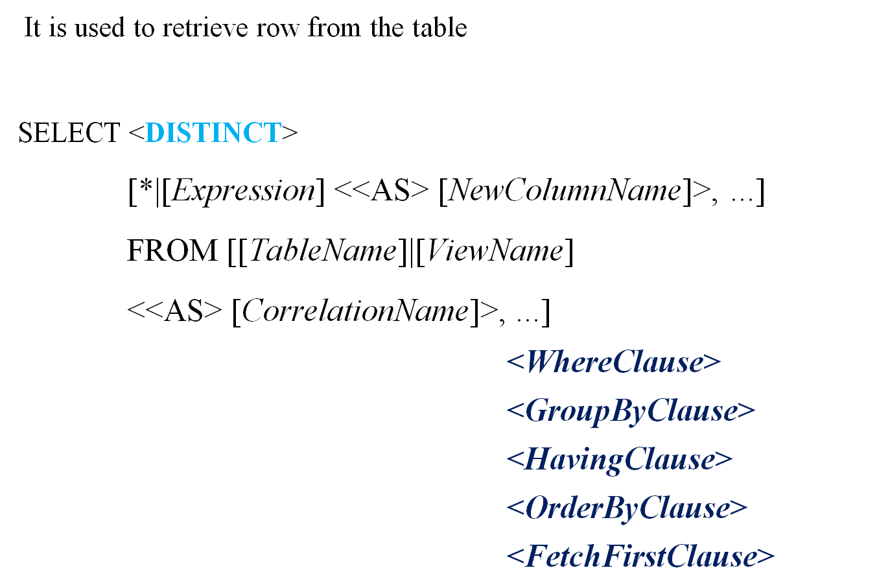
The SELECT Statement

Slide 16
COMMIT and ROLLBACK
The COMMIT statement commits the database changes that were made during the current transaction, making the changes permanent.
SYNTAX: COMMIT;
The ROLLBACK statement backs out, or cancels, the database changes that are made by the current transaction and restores changed data to the state before the transaction began.
SYNTAX : ROLLBACK;

Slide 17
GRANT and REVOKE
It is used to give privileges on table.
GRANT SYNTAX:
GRANT SELECT, INSERT, DELETE ON TABLENAME FOR RACFID;
REVOKE SYNTAX:
REVOKE INSERT, DELETE ON TABLENAME FROM RACFID;

Slide 18
Thank you

